Slide 1
Capstone Project 5
Face Emotion Recognition
Team Members
Sumeet Agrawal
Rajashekar Korutla

Slide 2
Problem Statements
Data Summary
Missing Values & Data Types
Exploratory Data Analysis
Model Formulation
Accuracy & Performance
Deployment
Challenges
Conclusion
Contents

Slide 3
Problem Statement
Face detection has been around for ages, taking a step forward, human emotion displayed by face and felt by brain captured in other video electric signal or image form can be approximated. Human emotion detection is the need of the hour so that modern artificial intelligence systems can emulate and gauge reactions from face. This can be helpful to make informed decisions be it regarding identification of intent, promotion of offers or security related threats.
So our objective in this project is to train a deep learning model which can detect the emotion of face.

Slide 4
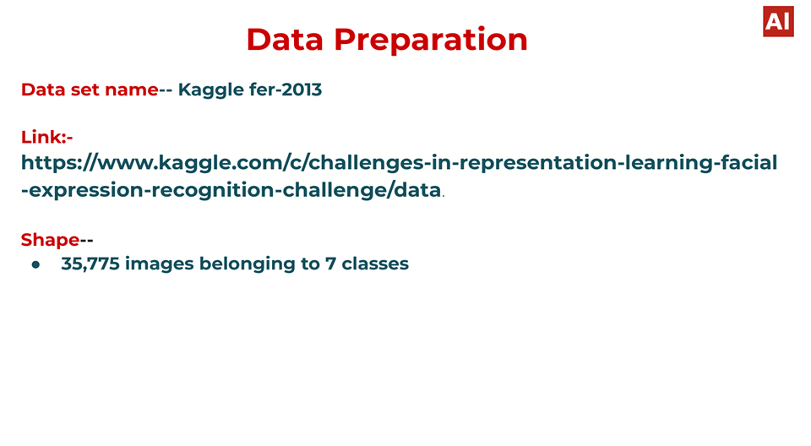
Data Summary
Dataset Name - Kaggle fer-2013
Shape of dataset - (35887, 3)

Slide 5
fer2013.csv
fer stands for FaceEmotionRecognition ,this is a dataset that has been created in the year 2013.
It consists of 48x48 pixel grayscale images of faces.
The task is to categorize each face based on the emotion shown in the facial expression into one of seven categories.
Training set has 28709 examples and the public test set has 3589 examples.

Slide 6
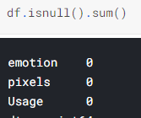
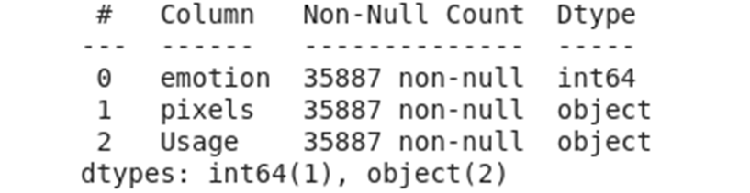
Missing Values and Data Types

Slide 7
Important Variables
1. Emotions - This features defines the emotion of the faces. It have 7 different classes of emotions -
Fear
Disgust
Angry
Happy
Neutral
Sad
Surprise
2. Pixels - This feature defines the pixels of the images.

Slide 8
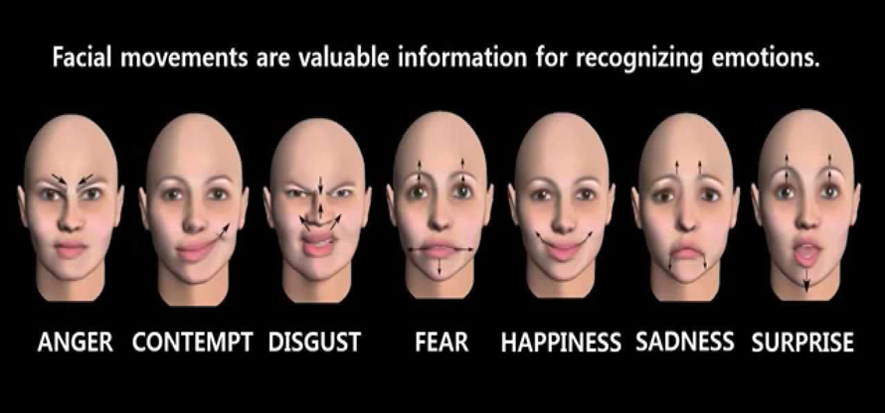

Slide 9
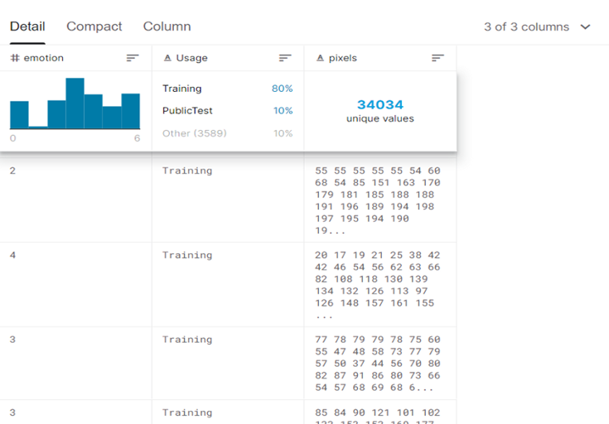
Details of Splitting Data

Slide 10
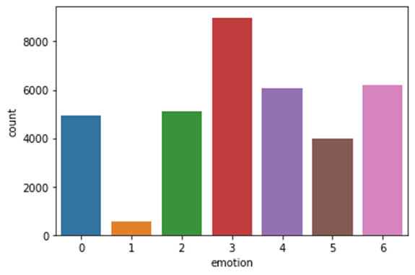
Count plot of various emotions

Slide 11
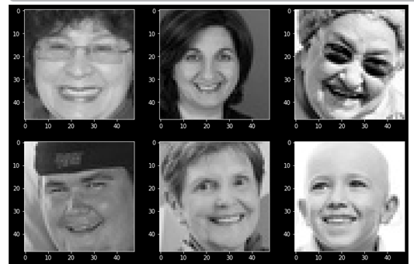
Displaying certain images
expression = 'happy'

Slide 12
Model Building, Training , Accuracy and Deployment

Slide 13
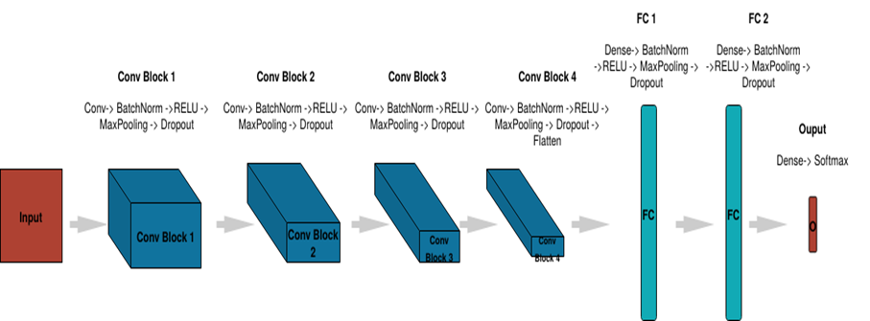
CNN (Convolutional Neural Network)

Slide 14
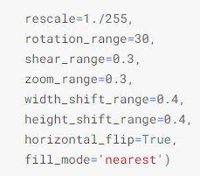
Data Augmentation
The performance of deep learning neural networks often improves with the amount of data available. Data augmentation is a technique to artificially create new training data from existing training data.This means, variations of the training set images that are likely to be seen by the model.

Slide 15
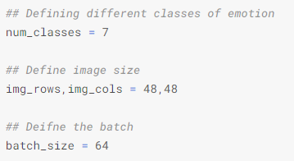
Model Hyper Parameters
Batch Size - The batch size is a hyperparameter that defines the number of samples to work through before updating the internal model parameters.
Epoch - The number of epochs is a hyperparameter that defines the number times that the learning algorithm will work through the entire training dataset.

Slide 16
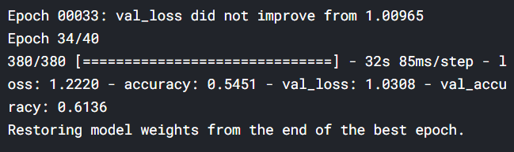
Accuracy score

Slide 17
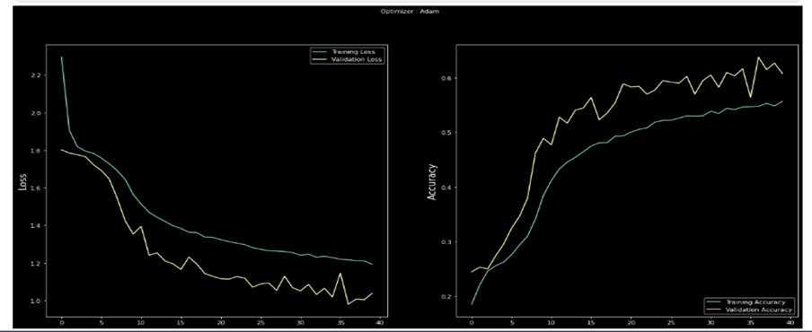
Accuracy and Loss

Slide 18
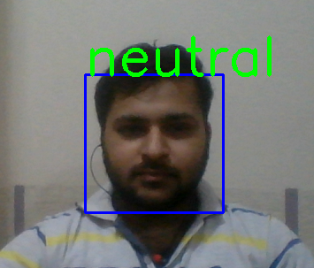
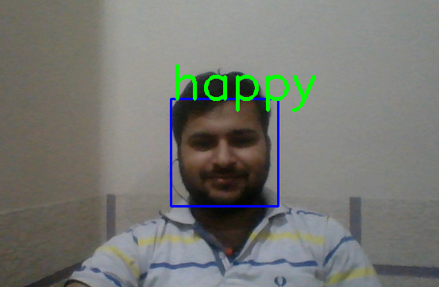
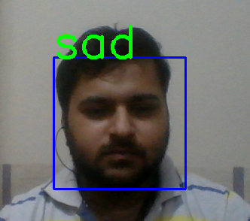
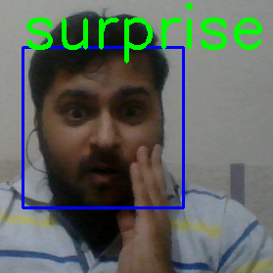
Testing With Web Cam

Slide 19




Testing with Web Cam

Slide 20
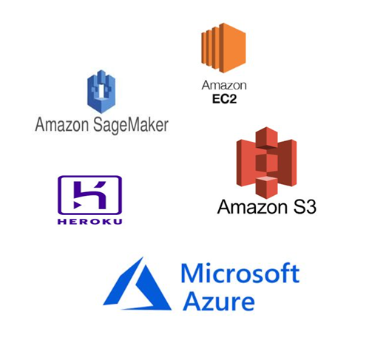
Deployment
Amazon(AWS) EC2
AWS Sage-maker(AWS) s3 Bucket
Heroku
Microsoft Azure

Slide 21
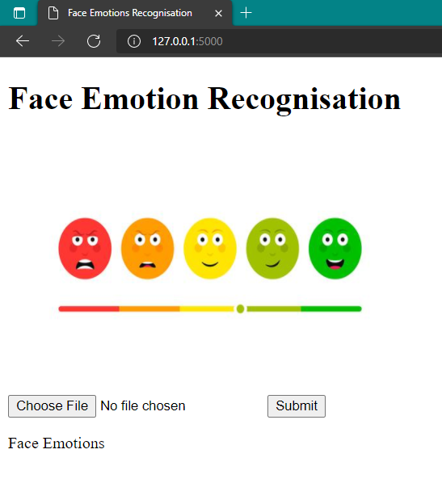
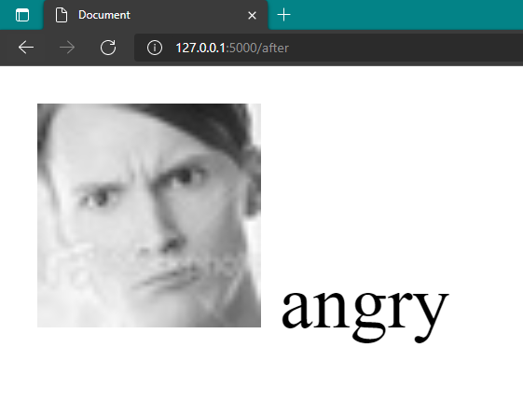
Deployment

Slide 22
Challenges
Gather the data.
We got only 38k images for training due to which our accuracy be affected.
For achieving good accuracy we need more training data.
Training model on 38k images taking too much time. So, we took the help of kaggle notebook for training model.
Deployment has been one of the most challenging thing in this project.

Slide 23
Conclusions
The shape of the dataset is (35887 , 3).
There are 7 different classes of emotions.
We use technique FERC for model training.
Our model Accuracy is around 55%
For model deployment we use Azure Cloud Services.

Slide 24
Scope for improvement
The model has been trained with only 38k input images. In future ,gathering more input images could improve the performance of the model.
Optimal Hyper parameters tuning could improve the accuracy of the model.

Slide 25
THANK YOU

